Slide 1

Operating system

Slide 2
OUTLINE
CPU Scheduling Algorithms
Shortest Remaining Time First (SRTF)
Round Robin scheduling
Priority scheduling

Slide 3
SRTF Example 1
Consider four processes P1, P2, P3 and P4. Calculate the average waiting time using SRTF.
Process Arrival Time Burst Time
P₁ 0.0 7
P₂ 2.0 4
P₃ 4.0 1
P₄ 5.0 4
Average waiting time = (9 + 1 + 0 +2)/4 = 3
P₁
P₂
P₃
P₂
P₄
P₁
0
2
4
5
7
11
16

Slide 4
SRTF Example 1
Consider four processes P1, P2, P3 and P4. Calculate the average waiting time using SRTF.
Process Arrival Time Burst Time
P₁ 0.0 7
P₂ 2.0 4
P₃ 4.0 1
P₄ 5.0 4
SJF (preemptive)
Average waiting time = (9 + 1 + 0 +2)/4 = 3
P₁
P₂
P₃
P₂
P₄
P₁
0
2
4
5
7
11
16

Slide 5
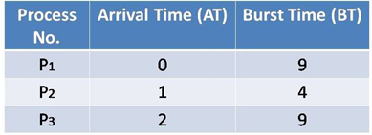
SRTF Example 2
Consider three processes P1, P2 and P3. Calculate the average waiting time using SRTF.
Sol:
Design the Gantt chart according to SRTF algorithm

Slide 6

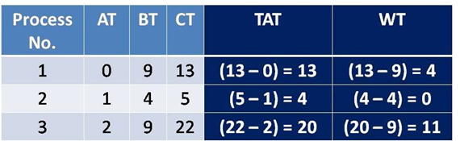
SRTF Example 2
Consider three processes P1, P2 and P3. Calculate the average waiting time using SRTF.
Sol:
Design the Gantt chart according to SRTF algorithm
Average waiting time = (4 + 0 + 11)/3 = 5 msec

Slide 7
Id | A.T. | B.T.
A | 2 | 5
B | 1 | 9
C | 0 | 16
D | 3 | 8

Slide 8
P.Id | A.T | B.T.
A | 0 | 15
B | 1 | 9
C | 0 | 16
D | 2 | 8
E | 3 | 4

Slide 9
ROUND ROBIN SCHEDULING
Round Robin scheduling = FCFS + Preemption
Designed for time sharing systems
A small unit of time called time quantum/time slice is defined
Each process gets the CPU for this fixed time quantum during which it executes and after that it is preempted and added to the end of ready queue. Timer interrupts every quantum to schedule next process.
Lets say there are n processes in ready queue and time quantum is q time units,
Then, each process can execute for atmost q time on CPU.
Each process gets 1/n CPU time in chunks of atmost q time units at a time.
No process has to wait for more than (n-1)q time (considering no context switch time)

Slide 10
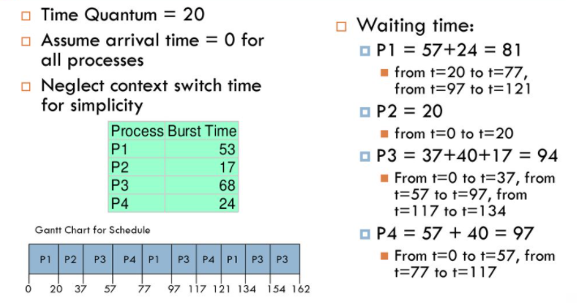
ROUND ROBIN SCHEDULING
Avg waiting time: (81 + 20 + 94 + 97)/4 = 73
Img Src: https://slideplayer.com/slide/14509341/

Slide 11
Round Robin Scheduling
Advantages: No starvation, fair time and resource sharing, and good response time
Disadvantages: High avg turnaround time than SRTF, does not consider priority, context switch
Performance:
If q is large, RR becomes FCFS and leads to poor waiting time
If q is small, overhead is too high and inefficient CPU utilization (q must be large than context switch time).
Usually, q =10 to 100 milliseconds, and Context switch < 10 microseconds

Slide 12
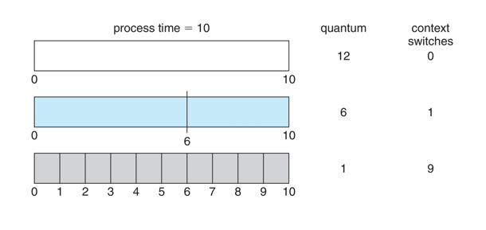
Round Robin Scheduling
Time quantum and Context switch

Slide 13
Round Robin Scheduling: Sample Problem
Consider the set of 5 processes whose arrival time and burst time are given below-
If the CPU scheduling policy is Round Robin with time quantum = 2 unit, calculate the average waiting time and average turn around time.
Process Id | Arrival time | Burst time
P1 | 0 | 5
P2 | 1 | 3
P3 | 2 | 1
P4 | 3 | 2
P5 | 4 | 3

Slide 14
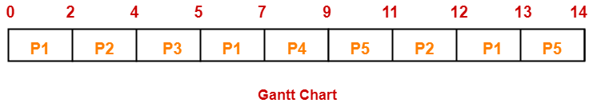
Round Robin Scheduling: Sample Problem
Ready Queue: P5, P1, P2, P5, P4, P1, P3, P2, P1
Turn Around time = Exit time – Arrival time
Waiting time = Turn Around time – Burst time

Slide 15
Round Robin Scheduling: Sample Problem
Process Id | Exit time | Turn Around time | Waiting time
P1 | 13 | 13 – 0 = 13 | 13 – 5 = 8
P2 | 12 | 12 – 1 = 11 | 11 – 3 = 8
P3 | 5 | 5 – 2 = 3 | 3 – 1 = 2
P4 | 9 | 9 – 3 = 6 | 6 – 2 = 4
P5 | 14 | 14 – 4 = 10 | 10 – 3 = 7
Average Turn Around time = (13 + 11 + 3 + 6 + 10) / 5 = 43 / 5 = 8.6 unit
Average waiting time = (8 + 8 + 2 + 4 + 7) / 5 = 29 / 5 = 5.8 unit

Slide 16
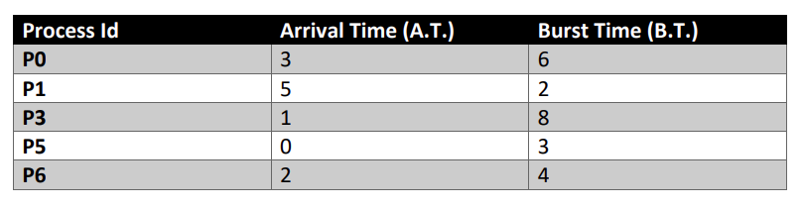
Find out the average turnaround time and average waiting time using Round robin scheduling algorithm with Time quantum 2 units.

Slide 17
PRIORITY SCHEDULING
A priority number (integer) is associated with each process
The CPU is allocated to the process with the highest priority (smallest integer = highest priority)
Preemptive
Non-preemptive
SJF is priority scheduling where priority is CPU burst time
In FCFS, there are equal priority processes
Advantage: Prioritize important jobs
Problem: Starvation – low priority processes may never execute
Solution: Aging – as time progresses increase the priority of the process

Slide 18
PRIORITY SCHEDULING
Priority can be defined either internally or externally
Internally, priority can be computed on the basis of some measurable quantity like
Time limit, memory requirements, number of open files, etc.
Externally, priority can be set by criteria such as
Urgency, importance of the process, etc.

Slide 19
PRIORITY SCHEDULING: EXAMPLE
Process Burst Time Priority
P₁ 10 3
P₂ 1 1
P₃ 2 4
P₄ 1 5
P₅ 5 2

Slide 20
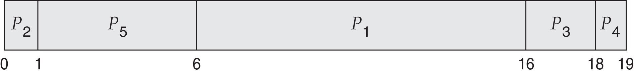
PRIORITY SCHEDULING: EXAMPLE
Process Burst Time Priority
P₁ 10 3
P₂ 1 1
P₃ 2 4
P₄ 1 5
P₅ 5 2
Priority scheduling Gantt Chart
Average waiting time = 8.2

Slide 21
PRIORITY SCHEDULING: SAMPLE PROBLEM
Considering preemptive priority scheduling, calculate average waiting time?
Process | Priority | Burst time | Arrival time
P1 | 1 | 4 | 0
P2 | 2 | 3 | 0
P3 | 1 | 7 | 6
P4 | 3 | 4 | 11
P5 | 2 | 2 | 12

Slide 22
PRIORITY SCHEDULING: SAMPLE PROBLEM
Solution:
P1 = o - o = o
P2 =4 - o + 7 =11
P3= 6-6=0
P4= 16-11=5
Average Waiting time = (0+11+0+5+2)/5 = 18/5= 3.6

Slide 23
Thank You

